Slide 1
Internet Routing Registry Tutorial

Slide 2
Prerequisites
You should have some idea of how Internet peering and transit works
You should have conceptual BGP skills
You should know how to manipulate objects in a WHOIS database

Slide 3
The IRR
Concept of “the” Internet Routing Registry system established in 1995
Web site at http://www.irr.net
Initially RIPE-(1)81 format, shifted to RPSL
Mirror routing registry data in a common repository for simplified queries - “the union of world-wide routing policy databases”

Slide 4
The IRR
Today, consists of about 40 registries operated by
RIRs (AfriNIC / RIPE)
ISPs (NTT / CenturyLink, C&W)
Non-affiliated public registries (RADB / ALTDB)

Slide 5
The RADB
Routing Arbiter DataBase (managed by Merit)
One of the earliest routing registry databases

Slide 6
Why use an IRR?
Document routing policy
Register route objects to associate network prefixes with origin AS
Solves the problem of: What prefixes should my peer / customer be announcing to me?

Slide 7
Why use an IRR?
A number of transit providers require their customers to register routes and filter customer route announcements based on registry contents.
Filters prevent unauthorised announcements; protects against route hijacking, denial of service, etc

Slide 8
Querying the IRR
Historically, IRRs have the “WHOIS” protocol (TCP 43)
Two primary IRR server implementations
RIPE DB from RIPE NCC
IRRd server from Merit
Some IRRs offer Web/REST based queries
Possible to run your own IRRd.

Slide 9
RPSL specifics
Each object type (class) contains mandatory and optional attributes
All objects must have these attributes:
mnt-by: identifies mntner object that controls the objects
changed: lists email and time of change
source: identifies the registry name where the object is located

Slide 10
Using the IRR
You need an AS number to use a registry (Ask your RIR)
You need a mntner object (ie. be safe)
You need an autnum object (ie. have an ASN)
You need route object(s)

Slide 11
mntner object
mntner is an abbreviation of maintainer
identifies accounts in the registry
specifies authentication mechanism in the “auth” attribute. Either:
PGP-KEY - PGP/GPG based auth
(B)CRYPT-PW / MD5-PW - password auth
MAIL-FROM - email based auth

Slide 12
mntner object
mntner is an abbreviation of maintainer
identifies accounts in the registry
specifies authentication mechanism in the “auth” attribute. Either:
PGP-KEY - PGP/GPG based auth
BCRYPT-PW
CRYPT-PW / MD5-PW - password auth
MAIL-FROM - email based auth
DEPRECATED

Slide 13
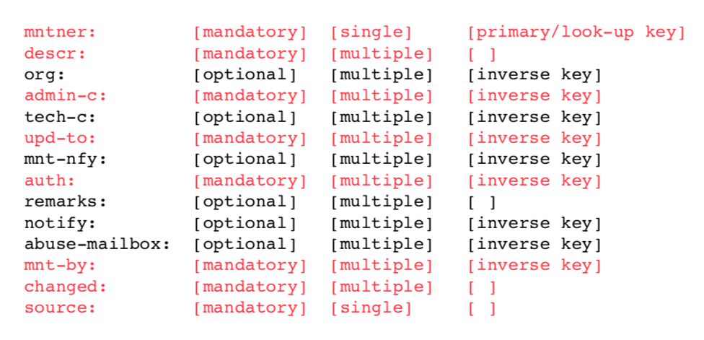
Sample mntner object

Slide 14
aut-num object
Defines routing policy for an AS
Uses import: and export: attributes to specify policy
Can be used for highly detailed policy descriptions and automated config generation
Can reference other registry objects such as as-sets, route-sets, and filter-sets

Slide 15
Sample aut-num object
aut-num: AS42
as-name: UNSPECIFIED
descr: Packet Clearing House - www.pch.net
admin-c: Bill Woodcock
tech-c: Bill Woodcock
export: to AS-ANY announce AS-PCH
remarks: peering@pch.net, +1 866 BGP PEER
notify: radb@pch.net
mnt-by: MAINT-AS3856
changed: scg@pch.net 20041121
source: RADB

Slide 16
Alternate aut-num uses
Often used to register BGP community support offered by service providers
Example: whois -h whois.radb.net AS1273
For a more comprehensive list, see: http://www.onesc.net/communities

Slide 17
route object
Defines a CIDR prefix and origin AS.
Most common type of object found in routing registries
Used by a number of ISPs to generate filters for their customer BGP sessions
Customers must register all routes in order for their ISP to route them
Allows automation of adding new prefixes to filter sets operated by ISPs

Slide 18
Sample route object
route: 160.0.0.0/17
descr: Packet Clearing House
origin: AS715
notify: radb@pch.net
mnt-by: MAINT-AS3856
changed: kabindra@pch.net 20170705
source: RADB

Slide 19
route object key
Every RPSL object has a primary key
For most classes it is simply the main class attribute value
For example, the mntner class uses the mntner attribute value as the key
However route objects use both router and origin fields as the primary key

Slide 20
route object key
There can be multiple objects for the same prefix with different origins
This is by design
multi-origin multi-homing
when changing to a new origin AS, want routes for both until switched

Slide 21
route object key example
However, many stale objects exists (ISPs are lazy! )
whois -h whois.radb.net 158.80.0.0/21
(look at the dates)

Slide 22
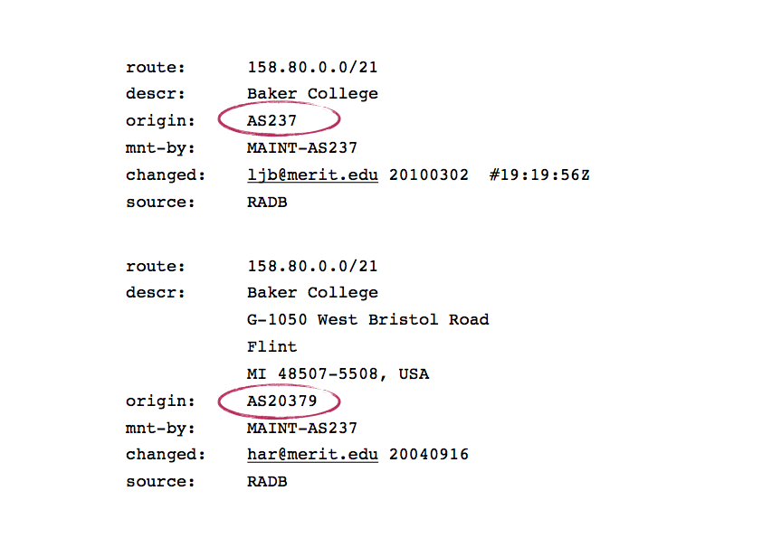

Slide 23
route6 object class
Like route object, but for IPv6 prefixes
Defined in RFC4012
Functionally equivalent to IPv4

Slide 24
Sample route6 object
route6: 2001:43f8:110::/48
descr: AFRINIC-RFC5855
origin: AS37181
mnt-by: AFRINIC-IT-MNT
source: AFRINIC # Filtered

Slide 25
as-set object
Provides a way of grouping ASes. Name must begin with the prefix “AS-”
Frequently used to list downstream/customer AS numbers
May be referenced in aut-num import/export policy expressions
Can reference another as-set

Slide 26
Sample as-set object
whois -h whois.radb.net AS-PCH

Slide 27
as-set: AS-PCH
descr: ASes announced by Packet Clearing House
members: AS3856, AS42, AS715, AS-RS, AS32978, AS32979, AS35160, AS38052, AS16668, AS44876, AS45170, AS297, AS45494, AS27678, AS52306, AS52234, AS54145, AS187, AS27, AS54390, AS11893, AS52304, AS21556, AS19281, AS10886
admin-c: Bill Woodcock
tech-c: Bill Woodcock
notify: radb@pch.net
mnt-by: MAINT-AS3856
changed: kabindra@pch.net 20171013
source: RADB

Slide 28
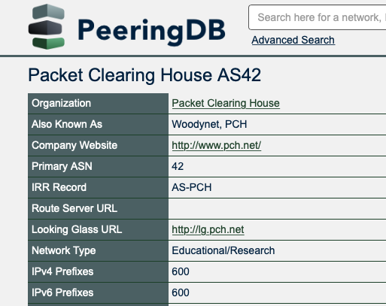
Look familiar?
Pro-tip: Try to make the name something meaningful and easy to guess

Slide 29
More reading
RFC 2650 - Using RPSL in practice
RFC 2725 - Routing Policy System Security
RFC 2726 - PGP Authentication for RIPE Database Updates
RFC 2769 - Routing Policy System Replication
RFC 4012 - RPSLng - RPSL extensions

Slide 30
4byte / 32bit ASNs
RFC 4893 defines 32bit ASN support
RFC 5396 standardised representation
asplain format uses simple integers (AS327576 vs. AS5.1)
RPSL implementations and routing registries have 32bit ASN support

Slide 31
<pause>

Slide 32
Sample queries
IRRs support a number of flag options. eg. “-i” flag performs inverse query
“-i mnt-by MAINT-AS3856” returns all routes objects maintained by MAINT-AS3856
“-i origin AS42” returns all route objects with an origin of AS42
-M flag returns more specific router objects for a prefix
“-M 70.40.0.0/21” returns more specific objects in the 70.40.0.0/21 prefix

Slide 33
More queries
-s flag limits the sources queried
“-s RADB,AFRINIC”
-K flag - return primary keys only
Useful for router object queries; excludes extraneous fields not usually needed for policy
“-K 70.40.0.0” returns
route: 70.40.0.0/21
origin: AS42

Slide 34
More on RPSL
The aut-num object can be used to express an Autonomous System’s routing policy and peering information
Structured syntax allows for complex policy expressions
Some operators drive their network configuration from their RPSL data
Others simply use it to document AS relationships in a public way

Slide 35
Routing policy
2
20
1
3
AS1 provides transit to AS2 and AS3
AS1 peers with AS20

Slide 36
in RPSL
2
20
1
autnum: AS1
import: from AS2 accept AS2
import: from AS3 accept AS3
import: from AS20 accept AS20
export: to AS2 permit ANY
export: to AS3 permit ANY
export: to AS20 permit AS1 AS2 AS3
3

Slide 37
using as-set
2
20
1
autnum: AS-MY-ASONE
…
export: to AS20 permit AS-MY-ASONE
3

Slide 38
IRR Tools
IRRToolSet (http://irrtoolset.isc.org)
NET::IRR
RPSLtool - (http://www.linux.it/~md/software/)
IRRPT (https://sourceforge.net/projects/irrpt/)
bgpq3 (http://snar.spb.ru/prog/bgpq3/)
filtergen (Level 3)
whois -h filtergen.level3.net SOURCE::AS-SET
whois -h filtergen.level3.net RADB::AS-PCH

Slide 39
Problems with the IRR
Accuracy is not maintained
Verification is not possible
No consistency in usage

Slide 40
Problems with the IRR
Accuracy is not maintained
Verification is not possible
No consistency in usage
…and we’ll cover these later

Slide 41
Practical Exercises

Slide 42
Bilateral vs BGP-RS

Slide 43
What’s the end goal?
Filtering recap:
Reject RFC 1918, and Bogon nets
Reject Private ASN
Reject IXP networks
Reject based on “Peerlocking” rules
Allow IRR, WHOIS, RPKI, …
Reject all else

Slide 44
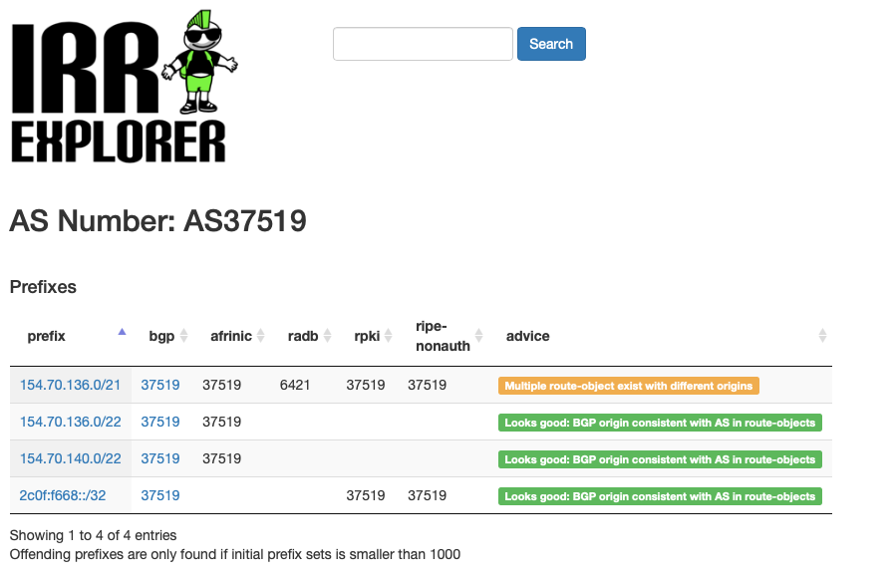
http://irrexplorer.nlnog.net

Slide 45
How to register an object?
pre-req: must have existing
mntnr (& associated nic-handle)
autnum
follow the rules of WHOIS operation
mailto: <auto-dbm@{irrd.operator}>
some IRRs have intuitive web interfaces

Slide 46
Registering objects
Did you remember to bring mntner password?
AfriNIC have a moderately useful GUI at https://whois.afrinic.net

Slide 47
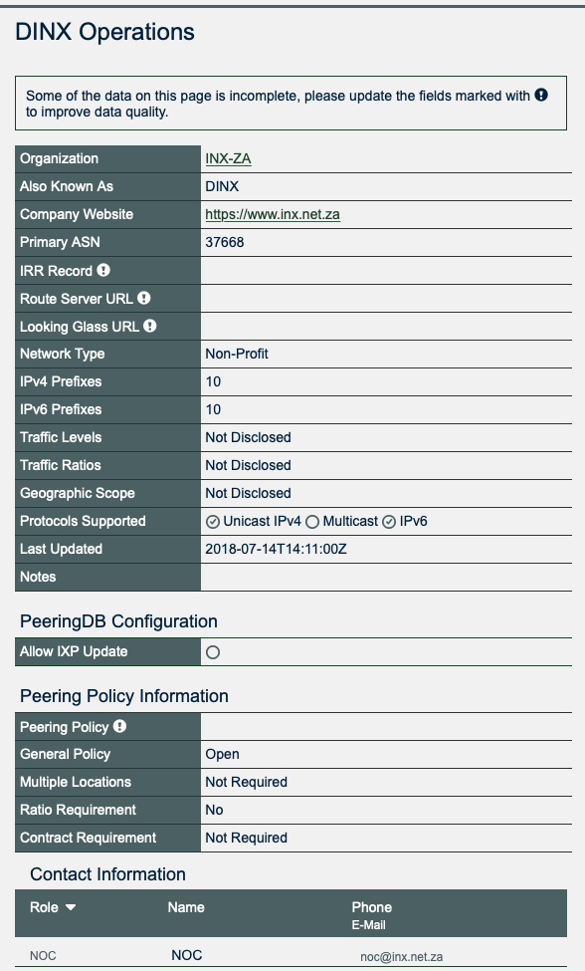
Go on, tick it ..
you know you want to …

Slide 48
Scenario #1:
You get new IP address space from your RIR. What are your actions?

Slide 49
Scenario #1:
You get new IP address space from your RIR. What are your actions?
Register new route object.
Origin ASN = your ASN

Slide 50
Scenario #2:
One of your customers gets new address space from [..]? What are your actions?

Slide 51
Scenario #2:
One of your non-BGP customers gets new address space from [..]? What are your actions?
Verify the address space using WHOIS
Register a proxy route object using your ASN

Slide 52
Scenario #3:
You get a new BGP capable customer. What are your actions?

Slide 53
Scenario #3:
You get a new BGP capable customer. What are your actions?
Get your customer to register their routes (or AS-SET)
Append their AS (or AS-SET) to your AS-SET

Slide 54
IRRPT
Quick intro

Slide 55
Getting it running
Download it from Github.
Run php configure.php
Fix issues.
Profit in time :-)

Slide 56
Generating router configs
Replace Cisco with $prefered brand
root@Graphing:~/irrpt-master# bin/irrpt_pfxgen -f cisco 42
conf t
no ip prefix-list CUSTOMER:42
no ipv6 prefix-list CUSTOMERv6:42
ip prefix-list CUSTOMER:42 permit 4.67.64.0/22 le 24
ip prefix-list CUSTOMER:42 permit 9.9.9.0/24
ip prefix-list CUSTOMER:42 permit 31.135.128.0/19 le 24
ip prefix-list CUSTOMER:42 permit 38.124.249.0/24
<snip>
ipv6 prefix-list CUSTOMERv6:42 permit 2800:110:10::/48
ipv6 prefix-list CUSTOMERv6:42 permit 2801:140:10::/48
end
write mem

Slide 57
Generating mikrotik configs
Mikrotik needs an additional wrapper.
Download and unzip script into working directory
https://edd.za.net/download/mkirrpt.zip

Slide 58
./mk.sh AS42-infilter 42
root@Graphing:~/mikrotik# ./mk.sh AS42filters 42
/routing filter set [ find where chain=AS42filters-IPv4 ] comment="deleteme:";
/routing filter set [ find where chain=AS42filters-IPv6 ] comment="deleteme:";
/routing filter add chain=AS42filters-IPv4 prefix=4.67.64.0/22 prefix-length=22-24 action=accept
/routing filter add chain=AS42filters-IPv4 prefix=9.9.9.0/24 action=accept
/routing filter add chain=AS42filters-IPv4 prefix=31.135.128.0/19 prefix-length=19-24 action=accept
/routing filter add chain=AS42filters-IPv4 prefix=38.124.249.0/24 action=accept
/routing filter add chain=AS42filters-IPv4 prefix=45.221.0.0/22 prefix-length=22-24 action=accept
/routing filter add chain=AS42filters-IPv4 prefix=45.221.16.0/22 prefix-length=22-24 action=accept
/routing filter add chain=AS42filters-IPv4 prefix=45.250.60.0/22 prefix-length=22-24 action=accept
<snip>
/routing filter add chain=AS42filters-IPv6 prefix=2801:140:10::/48 action=accept
/routing filter add chain=AS42filters-IPv6 action=reject
/routing filter remove [ find where chain=AS42filters-IPv4 and comment="deleteme:" ]
/routing filter remove [ find where chain=AS42filters-IPv6 and comment="deleteme:" ]

Slide 59
Batch filter generation!
Edit as.txt with asns or route sets
./batchmikrotik.sh > rules.txt
Copy to mikrotik
Import $filename

Slide 60
Want notices when prefixes change?
Edit conf/irrdb.conf
Cron bin/irrpt_fetch
Receive email once it changes.

Slide 61
Other useful things
Plug it into Rancid,
Use Net::Telnet::Cisco or JUNOScript to dump configs to routers

Slide 62
Problems
Suffers with big route sets eg. he.net

Slide 63
bgpq3

Slide 64
Using bgpq3
We’re going to use bgpq3 (because it’s fast) to help us create filters for some of our peers.
Install bgpq3 on a *NIX host (or if you’re forced to use Windows ask someone here for a shell)
Find it in your OS repository, or download from GH: https://github.com/snar/bgpq3

Slide 65
Supplementary tools
ixgen: https://github.com/ipcjk/ixgen
pinder: https://github.com/dotwaffle/pinder

Slide 66
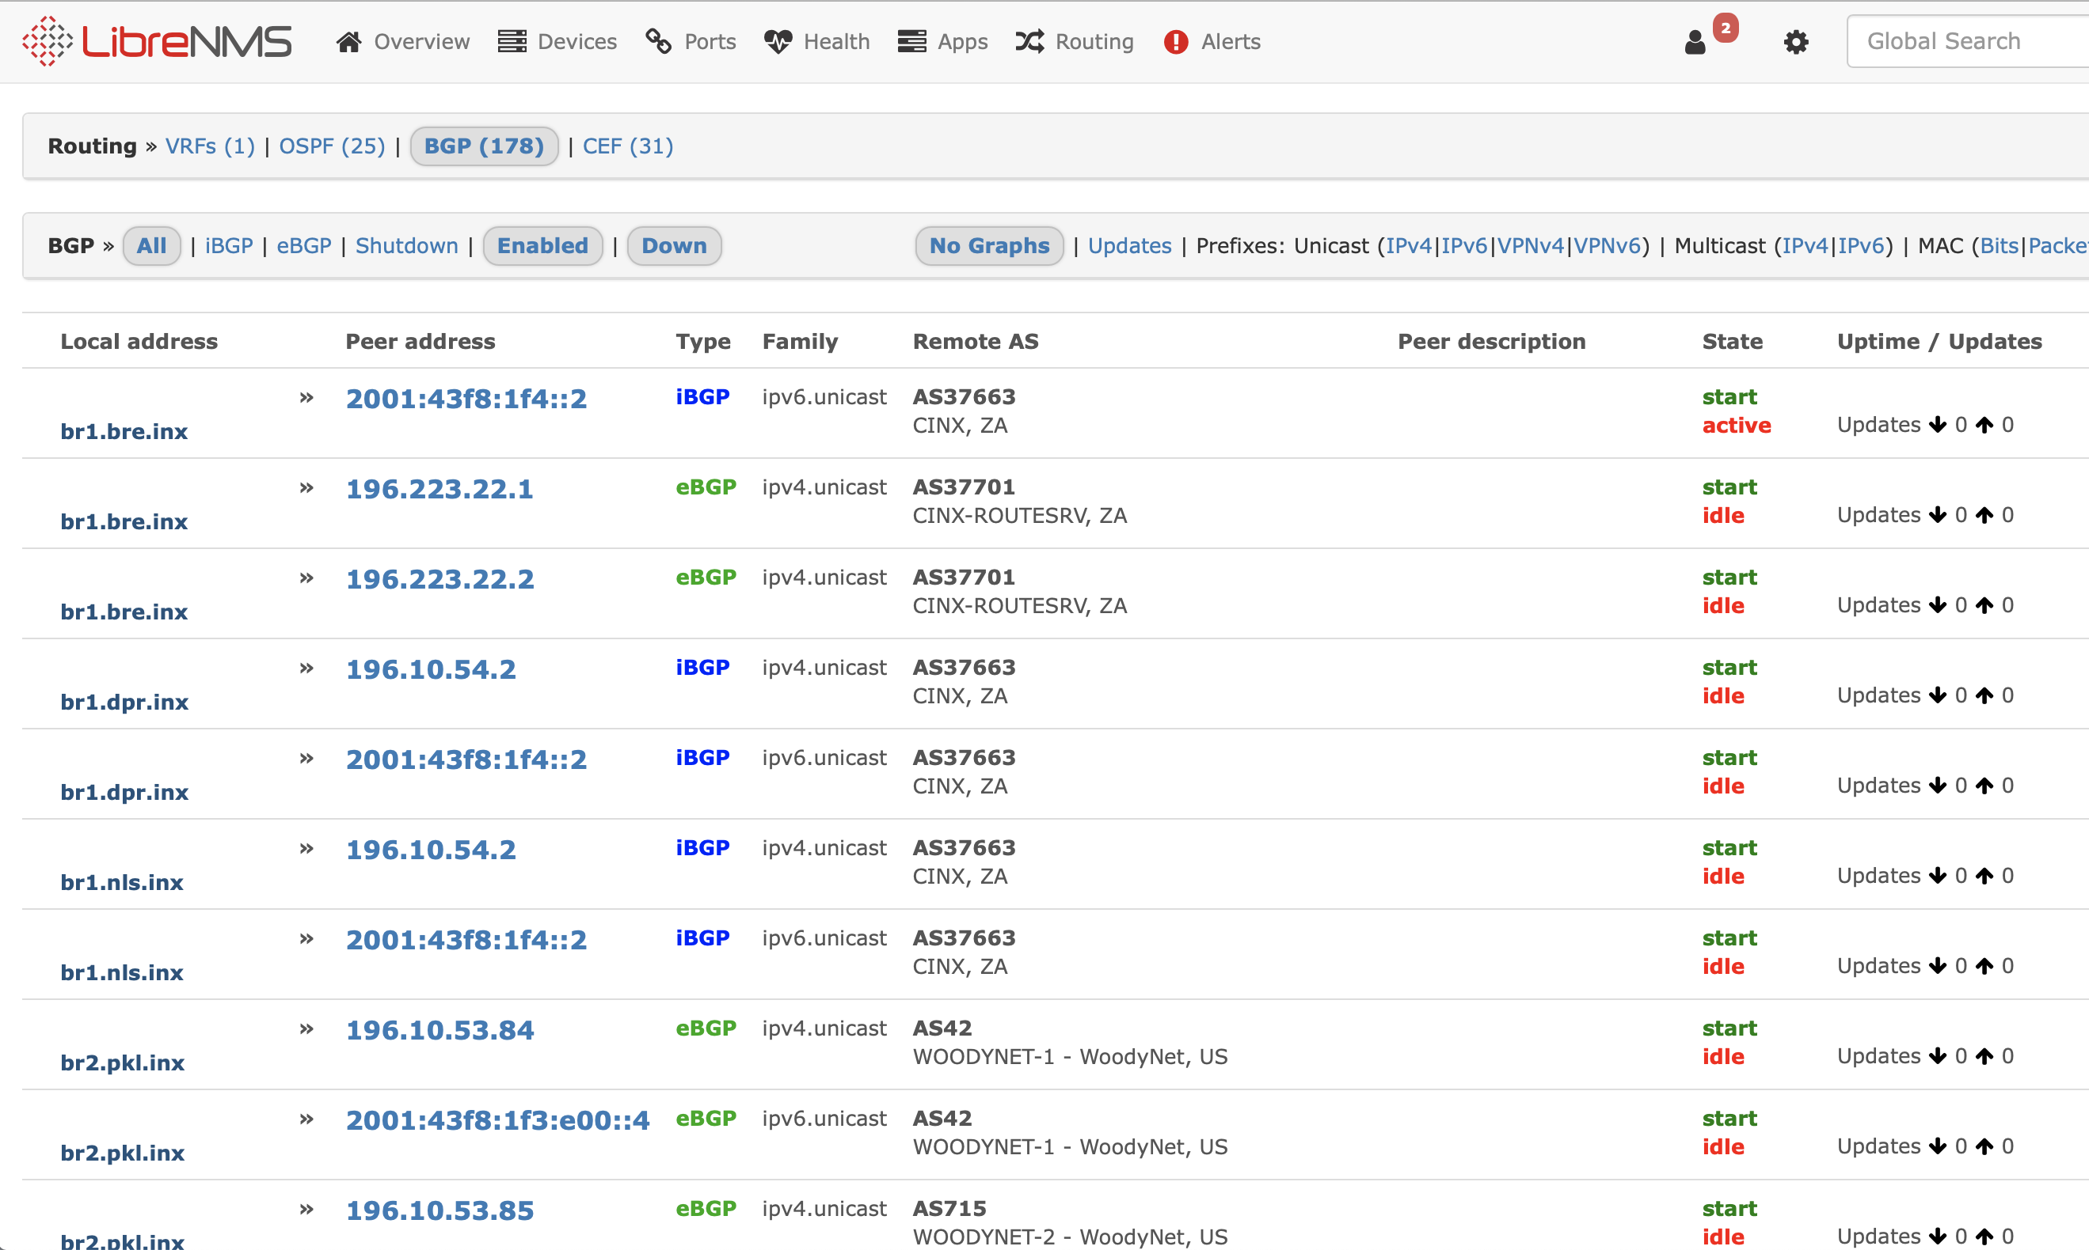
LibreNMS + Peeringdb

Slide 67
RPKI

Slide 68
RPKI
Provides a cryptographically verifiable means to validate information that is in the database.
Solves the question of: Is that ASN authorised to originate that prefix
Often called: “Origin Validation”

Slide 69
RPKI
Concept of private and personal keys hasn’t changed.
2 implementation methods (delegated or hosted)

Slide 70
RPKI Building blocks
Trust Anchors
ROAs
Validators

Slide 71
RPKI
Builds trust by building a chain of certificates
TA (Trust Anchor) being the top most CA
EE certificates at the leaf level (ROA)
Certificates contain Internet resources
Validation works by running the chain of trust from root to leaves

Slide 73
What is a ROA
A ROA is a digitally signed object that provides a means of verifying that an IP Address block holder has authorised an Autonomous System (AS) to originate routes to one of more prefixes within the address block.

Slide 74
What is a ROA
A ROA is a digitally signed object that provides a means of verifying that an IP Address block holder has authorised an Autonomous System (AS) to originate routes to one of more prefixes within the address block.
ie. x509 cert …

Slide 75
ROAs
Simply construct of:
prefix
asn
min + max prefix_length
expiry date
ROAs can overlap
Multiple ROAs can exist

Slide 76
Trust anchors
RIRs have these for the majority blocks
RIRs have complicated rules for dealing with minority blocks
4x RIRs publish these easily; ARIN makes you sign some legal stuff
A URL and a Public Key that must be able to decrypt the cert found at the URL (so you know you can trust it)

Slide 77
Validators
Software.
Current favorite : Routinator 3000
https://nlnetlabs.nl/projects/rpki/routinator/
RIPE NCC V2 (v3 in dev)
Speaks rsync to trust anchors to synchronise ROAs
Performs validation
Speaks RPKI-RTR protocols to routers

Slide 78
Validators
Produces a result that is either
0 - NotFound
1 - Valid
2 - Invalid

Slide 79
AFRINIC
APNIC
ARIN
RIPE-NCC
LACNIC
CACHE
R1
R2
R3

Slide 80
Configuring your device
https://www.inx.net.za/display/pub/RPKI+Validation
Cisco IOS 15.2+
Cisco IOS/XR 4.3.2+
JunOS 12.2+
Mikrotik v7.x 😂

Slide 81
thanks randy!

Slide 85
In real life
conf t
router bgp 37474
bgp rpki server tcp 196.10.53.22 port 3323 refresh 600

Slide 86
Practical Use case
route-map MatchRPKIState0
match rpki valid
set local-preference 100
route-map MatchRPKIState1
match rpki not-found
set local-preference 50

Slide 87
Placing your Caches.
Regional
Cache
Regional
Cache
In-POP
Cache
In-POP
Cache
in-POP
Cache
In-POP
Cache

