Slide 1
Introduction to Ansible
Presented by
Frank Kuse

Slide 2
Introduction to Ansible
Ansible is a radically simple IT automation platform that makes your applications and systems easier to deploy.
It support configuration management with examples as below.
    Configuration of servers
    Application deployment
    Continuous testing of already install application
    Provisioning
    Orchestration
    Automation of tasks

Slide 3
Why Automation?
Tasks in code
Collaboration
Eliminate errors
Write once
Laziness
Etc….

Slide 4
Why Ansible
It is a free open source application
Agent-less – No need for agent installation and management
Phython/yaml based
Highly flexible and configuration management of systems.
Large number of ready to use modules for system management
Custom modules can be added if needed
Configuration roll-back in case of error
Simple and human readable
Self documenting

Slide 5
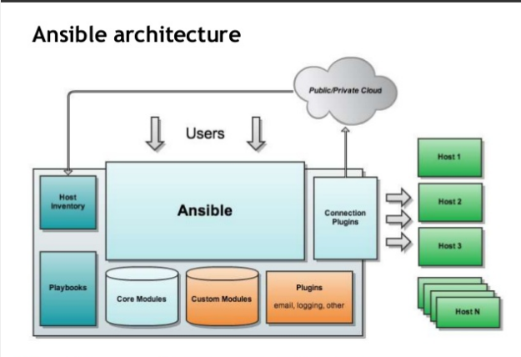
Ansible Architecture

Slide 6
Installation of Ansible
Install packages below on the Server Machine
sudo apt-get install python-yaml python-jinja2 python-paramiko python-crypto python-keyczar ansible
Install packages below on the client Machines
sudo apt-get install python-crypto python-keyczar

Slide 7
Create the RSA Key Pair
The first step is to create the key pair on the Server machine
ssh-keygen –t rsa
Once you have entered the Gen Key command, you will get a few more questions:
Enter file in which to save the key (/home/test/.ssh/id_rsa):
Enter no password for the next prompt
Copy the Public Key
ssh-copy-id test@192.168.85.135
Repeat the same process for other machines you wish to login automatically with.
Ensure the test username has sudo access to the remote clients

Slide 8
Configuration of ansible
Do the following on the Server machine
Create the list of client machines you wish to access via this server
vi /etc/ansible/hosts ( And enter the following lines and save file)
[Servers]
192.168.85.135
192.168.85.136
Run the ping command below to see if indeed you are reaching both client nodes
ansible -m ping all

Slide 9
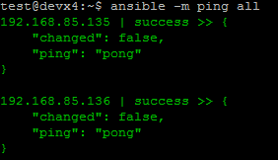
Examples of ansible commands
The output show ping result success as shown below

Slide 10
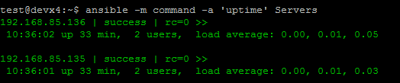
Examples of ansible commands (Cnt)
How to run commands to fetch hard drives utilization
ansible -m command -a 'df -h' Servers
How to run commands to fetch system uptime
ansible -m command -a ‘uptime' Servers

Slide 11
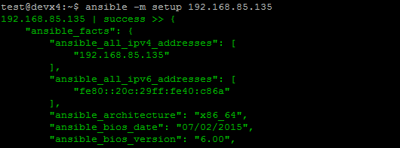
Examples of ansible commands ( Cnt)
The full configuration environment inventory of a particular client machine can be obtain using the command below.
ansible -m setup 192.168.85.135 ( output as shown below)

Slide 12
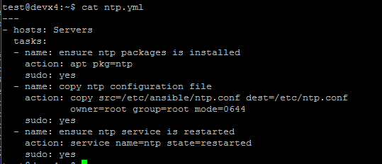
Creating an ansible-playbook template
Create a template to enable the installation of an NTP service with content as shown below and file saved as ntp.yml

Slide 13
Understanding ansible playbook configurations
In order to use ansible with SSH passwords you will need to install the program below
sudo apt-get install sshpass
Ansible-playbook command can be executed to run the ntp.yml file as below
ansible-playbook -k -K ntp.yml
The –k –K switches allow you to be able to use your ssh key and passwordless sudo.
Every playbook configuration begins with triple dash ( ----)
The hosts, tasks, name, action are various instructions commands to help automate your ntp installation process.

Slide 14
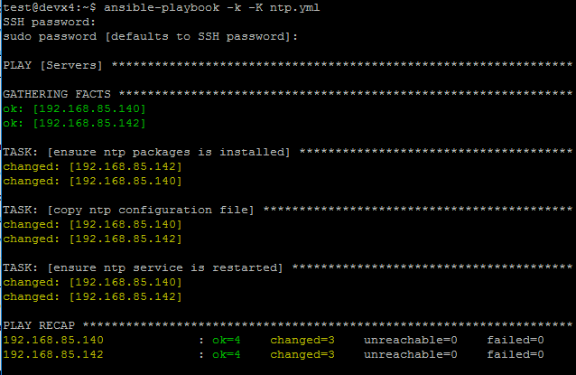
Understanding ansible playbook configurations (cnt)
The output of the ansible-playbook command as below

Slide 15
Ansible Documentations
You can find more explanation in the Ansible Docs.
  Ad-hoc commands
  Inventories
  Variables
  Modules
  Playbook Roles
Similar tools that does the same function as Ansible are as below.
  Puppet
  Chef
  Salt

