Slide 1
OSI and TCP/IP Models
And Some Vulnerabilities
AfNOG 12
30th May 2011 – 10th June 2011
Tanzania
By
Marcus K. G. Adomey

Slide 2
Open Systems Interconnection (OSI) model

Slide 3
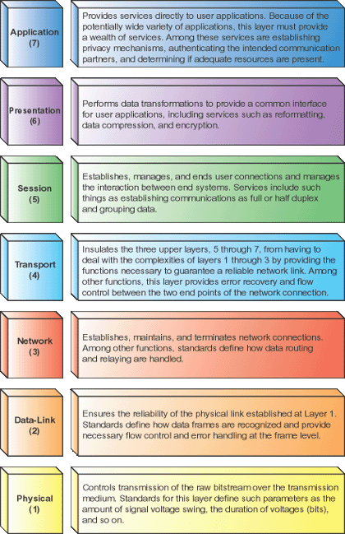

Slide 4
Acronym APSTNDP
All People Seem To Need Data Processing
Please Do Not Throw Sausage Pizza Away
Application, Presentation, Session, Transport, Network, Data Link, Physical
Aliens Probably Stole the Ninja Dew Pop
All Pirate Ships Take No Darn Prisoners
A Purple Snake Takes No Dead Prisoners
A Powered-Down System Transmits No Data Packets

Slide 5
Transmission Control Protocol (TCP) and the Internet Protocol (IP) Model

Slide 6
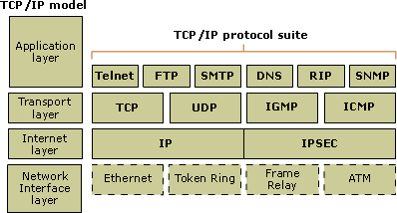

Slide 7
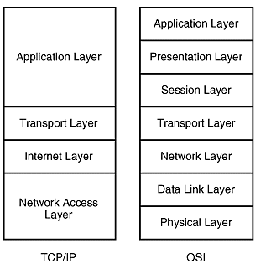

Slide 8
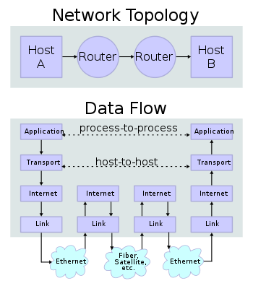

Slide 10
Some Vulnerabilities

Slide 11
TYPE | Vulnerability
Memory Base | Buffer Overflow
 | Format String Bug
 | Integer Overflows
Time and State Base | Session Hijacking
String Base | Race Condition
 | SQL Injection
 | Command Injection
 | Cross-Site Scripting
Design Base | Improper Use of SSL and TLS

Slide 12
Buffer Overflow
A buffer overflow occurs when a program or process tries to store more data in a buffer (temporary data storage area) than it was intended to hold. Since buffers are created to contain a finite amount of data, the extra information - which has to go somewhere - can overflow into adjacent buffers, corrupting or overwriting the valid data held in them.
Although it may occur accidentally through programming error, buffer overflow is an increasingly common type of security attack on data integrity.
In buffer overflow attacks, the extra data may contain codes designed to trigger actions, in effect sending new instructions to the attacked computer that could, for example, damage the user's files, change data, or disclose confidential information.

Slide 13
Format string bugs
Format string bugs are not exactly the same as a buffer overflow, but because they lead to the same problems, they are included in this section.
The basic problem of format string bugs stems from the fact that there is no realistic way for a function that takes a variable number of arguments to determine how many arguments were passed in.

Slide 14
Integer Overflow
An integer overflow occurs when an arithmetic operation attempts to create a numeric value that is larger than can be represented within the available storage space. For instance, adding 1 to the largest value that can be represented constitutes an integer overflow.
Integer overflows cannot be detected after they have happened, so there is not way for an application to tell if a result it has calculated previously is in fact correct. This can get dangerous if the calculation has to do with the size of a buffer or how far into an array to index. Of course most integer overflows are not exploitable because memory is not being directly overwritten, but sometimes they can lead to other classes of bugs, frequently buffer overflows.

Slide 15
Race Condition
A race condition occurs when multiple processes access and manipulate the same data concurrently, and the outcome of the execution depends on the particular order in which the access takes place.
A race condition is of interest to a hacker when the race condition can be utilized to gain privileged system access.

Slide 16
Session hijacking
Session hijacking is the exploitation of a valid computer session—sometimes also called a session key—to gain unauthorized access to information or services in a computer system. In particular, it is used to refer to the theft of a magic cookie used to authenticate a user to a remote server.

Slide 17
SQL injection
SQL injection is a code injection technique that exploits a security vulnerability occurring in the database layer of an application.
SELECT fieldlist
FROM customers
WHERE name = '\''; DROP TABLE users; --';

Slide 18
Command Injection
The purpose of the command injection attack is to inject and execute commands specified by the attacker in the vulnerable application.
In situation like this, the application, which executes unwanted system commands, is like a pseudo system shell, and the attacker may use it as any authorized system user. However, commands are executed with the same privileges and environment as the application has.
Command injection attacks are possible in most cases because of lack of correct input data validation, which can be manipulated by the attacker (forms, cookies, HTTP headers etc.).

Slide 19
Cross-Site Scripting
Cross-Site Scripting attacks are a type of injection problem, in which malicious scripts are injected into the otherwise benign and trusted web sites. Cross-site scripting (XSS) attacks occur when an attacker uses a web application to send malicious code, generally in the form of a browser side script, to a different end user.
Flaws that allow these attacks to succeed are quite widespread and occur anywhere a web application uses input from a user in the output it generates without validating or encoding it.

Slide 20
Directory Traversal
Directory Traversal is an HTTP exploit which allows attackers to access restricted directories and execute commands outside of the web server's root directory.
The goal of this attack is to order an application to access a computer file that is not intended to be accessible. This attack exploits a lack of security (the software is acting exactly as it is supposed to) as opposed to exploiting a bug in the code.
Directory traversal is also known as the ../ (dot dot slash) attack, directory climbing, and backtracking. Some forms of this attack are also

Slide 21
Directory Traversal
The Secure Socket Layer, SSL is the most popular protocol in the world for creating secure network connections.
When server authentication isn’t done properly, an attacker can eavesdrop, or modify or take over conversations, generally without being detected.

Slide 22
Thank You!!!

