Slide 1
CSIRT – Incident handling
Perpétus Jacques Houngbo
Dar Es Salaam, May – June 2011
“If you think technology can solve your security problems, then you don’t understand the problems and you don’t understand the technology”- Bruce Schneier
http://think.securityfirst.web.id/?page_id=12

Slide 2
References
Computer Security Incident Handling Guide
http://csrc.nist.gov/publications/nistpubs/800-61-rev1/SP800-61rev1.pdf
Notes:
2

Slide 3
Contents
Introduction: module objectives
Events, incidents
Incident response, incident handling, incident management
Incident handling
Preparation
Detection and analysis
Containment, eradication, recovery
Post incident activities
Conclusion
Notes:
3

Slide 4
Contents
Introduction: module objectives
Events, incidents
Incident response, incident handling, incident management
Incident handling
Preparation
Detection and analysis
Containment, eradication, recovery
Post incident activities
Conclusion
Notes:
4

Slide 5
Introduction
Why bother about incident handling:
The “if” is certain
The question is when
Objectives of the modules :
Familiarize with computer security incident
Arise awareness on preparation
Give first hands on training on incident detection
Present the complete lifecycle of incident handling
Notes:
5

Slide 6
Contents
Introduction: module objectives
Events, incidents
Incident response, incident handling, incident management
Incident handling
Preparation
Detection and analysis
Containment, eradication, recovery
Post incident activities
Conclusion
Notes:
6

Slide 7
Events, Incidents
Event – any observable occurrence within a system or network.
Adverse event – an event which has a negative consequence.
Security Incident - a violation or imminent threat of violation of IT security policies or standard security practices.
Notes:
7

Slide 8
Contents
Introduction: module objectives
Events, incidents
Incident response, incident handling, incident management
Incident handling
Preparation
Detection and analysis
Containment, eradication, recovery
Post incident activities
Conclusion
Notes:
8

Slide 9
Incident response, incident handling, incident management 1 / 3
Incident management:
Restore normal service as quickly as possible
Minimize adverse impact on business
Ensure no incident goes undetected
Ensure incidents are handled with consistent processes
Reduce number of incidents in time
Build working relationships across organization with open communication
Notes:
9

Slide 10
Incident response, incident handling, incident management 2 / 3
Incident management is part of risk management
Risk management:
coordinated activities to direct and control an organization with regard to risk
policies, procedures, and practices involved in identification, analysis, assessment, control, and avoidance, minimization, or elimination of unacceptable risks
Incident management encompasses (and is broader than) incident handling
Notes:
10

Slide 11
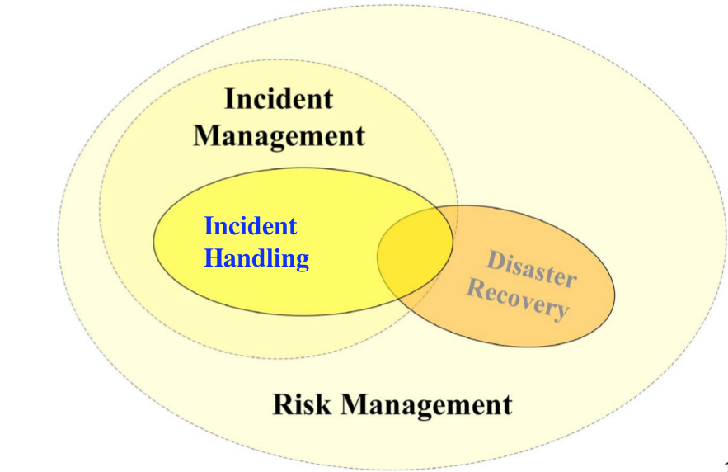
Source: Security Incident Handling, Shinil Hong, August, 2007
Incident response, incident handling, incident management 3 / 3
Notes:
11

Slide 12
Contents
Introduction: module objectives
Events, incidents
Incident response, incident handling, incident management
Incident handling
Preparation
Detection and analysis
Containment, eradication, recovery
Post incident activities
Conclusion
Notes:
12

Slide 13
Incident handling
Handling incident – several phases
preparation: limit the number of incidents that will occur
detection and analysis: security breaches, incident classification, signs of incidents
containment, eradication, recovery: limit the spread, gather evidences, eliminate components, restore system to normal operation
post incident activities: lessons learned, data collected
Notes:
13

Slide 14
Contents
Introduction: module objectives
Events, incidents
Incident response, incident handling, incident management
Incident handling
Preparation
Detection and analysis
Containment, eradication, recovery
Post incident activities
Conclusion
Notes:
14

Slide 15
Incident handling – Preparation
Establishing incident response capability (1/5)
Establishing incident response capability
Communications and Facilities
Analysis Hardware and Software
Analysis Resources
Mitigation Software
Notes:
15

Slide 16
Incident handling – Preparation
Establishing incident response capability (2/5)
Communications and Facilities
Contact information (team members)
On-call information
Incident reporting mechanisms
Pagers or cell phones
Encryption software / digital signature
War room
Secure storage facility
Notes:
16

Slide 17
Incident handling – Preparation
Establishing incident response capability (3/5)
Analysis Hardware and Software
Computer forensic workstations and/or backup devices
Spare workstations, servers, and networking equipment
Blank media, Removable media
Laptops, Easily portable printer
Packet sniffers and protocol analyzers
Computer forensic software
Evidence gathering accessories
Notes:
17

Slide 18
Incident handling – Preparation
Establishing incident response capability (4/5)
Analysis Resources
Port lists
Documentation
Network diagrams and lists of critical assets
Baselines
Cryptographic hashes
Mitigation Software
Media
Security patches
Backup images
Notes:
18

Slide 19
Incident handling – Preparation
Establishing incident response capability - Practice (5/5)
2 groups : CSIRT team members & Client side IT staff
Install PGP
Exchange email with : contact information, on-call information, Incident reporting mechanisms
Design a War room
Design a Secure storage facility
List some tools for packet sniffers and protocol analyzers
Enumerate tools for network diagrams and lists of critical assets
Notes:
19

Slide 20
Incident handling – Preparation
Making incident detection and analysis easy
Practice: Profile networks and systems
Study networks, systems, and applications to gain understanding of their normal behavior
Practice: Use centralized logging and create a log retention policy
Keep all host clocks synchronized
Maintain and use a knowledge base of information
Use internet search engines for research
Consider experience as being irreplaceable
Create a diagnosis matrix for less experienced staff
Notes:
20

Slide 21
Incident handling – Preparation
Preventing incidents (1/2)
Periodic risk assessments of systems and applications
identify potential problems before they occur
implement a genuine plan that clearly states how risks will be mitigated, transferred, avoided or accepted
Recommended practices for securing networks:
Patch management
Host security
Network security
Malicious code prevention
User awareness and training
Notes:
21

Slide 22
Incident handling – Preparation
Preventing incidents Practice (2/2)
Risk assessment: Failure Mode and Effects Analysis (FMEA) in practice
Patch management: WSUS, Update manager (Linux)
Host security : ISO 27001 A.11
Network security : ISO 27001 A.11.4
Malicious code prevention : ISO 27001 A.10.4
User awareness and training : ISO 27001 A.8.2
Notes:
22

Slide 23
Contents
Introduction: module objectives
Events, incidents
Incident response, incident handling, incident management
Incident handling
Preparation
Detection and analysis
Containment, eradication, recovery
Post incident activities
Conclusion
Notes:
23

Slide 24
Incident handling
Detection and analysis (1/11)
Incident categories: malicious code, DoS, etc.
Signs of an incident: events that trigger the process
Sources of precursors and indications: software alerts, log files, publicly available information, etc
Incident analysis: many activities to handled by well-trained and capable staff
Incident documentation: recording all facts regarding the incident
Incident prioritization: most critical decision point
Incident notification: timely reporting
Notes:
24

Slide 25
Incident handling - Detection & analysis (2/11)
Incident categories (1/4)
Denial of service: normal use of resources is impaired or blocked
Malicious code: host infected by virus, worm, trojan horse
Unauthorized access: logical or physical access without permission
Inappropriate usage: private computers/devices connected to the network
Multiple components
Notes:
25

Slide 26
Incident handling - Detection & analysis (3/11)
Incident categories (2/4)
Categories are based on the extent of harm and damages caused by incidents
Low level incidents: should be handled within one working day
Compromise of system password
Unknown sharing of company account
Misuse of computer peripherals
Unintentional routine computer action
Unsuccessful scans and probes in the network
Presence of computer virus and worms
Notes:
26

Slide 27
Incident handling - Detection & analysis (4/11)
Incident categories (3/4)
Mid level incidents: should be handled within two to four hours
Unfriendly employee termination
Violation of the access to information assets
Systems present in the organization used as unauthorized systems for processing and storing data
Destruction of property worth less than $100.000
Personal thief of amount less than $100.000
Presence of computer virus and worms
Notes:
27

Slide 28
Incident handling - Detection & analysis (5/11)
Incident categories (4/4)
High level incidents: should be handled immediately
“break-in” in any computer
Denial of services attack
Presence of computer virus and worms which lead to serious corruption or loss of data
Abnormal changes in the systems hardware, software and firmware
Illegal file download done by suspected or unknown users
Destruction of property which exceeds $100.000
Personal thief of amount which exceeds $100.000
Violation of law
Notes:
28

Slide 29
Incident handling - Detection & analysis (6/11)
Signs of incidents
Accurately detecting and assessing possible incidents
Intrusion detection/prevention system sensor alerts
Antivirus software alerts
Web server crashes
Users complain of slow access to hosts on the Internet
Discovery of filename with unusual characters
Users report threatening email message
Host records auditing configuration change in its log
Applications logs multiple failed login attempts from an unfamiliar remote system
Large number of bounced emails with suspicious content
Unusual deviation from typical network traffic flows.
Notes:
29

Slide 30
Incident handling - Detection & analysis (7/11)
Sources of Precursors and Indications
Computer Security Software Alerts
Logs from operating systems, services, and applications
Logs from network devices such as firewalls and routers
Publicly Available Information
Users, system administrators, network administrators, security staff, and others
Notes:
30

Slide 31
Incident handling - Detection & analysis (8/11)
Incident analysis
Determine
Incident’s scope: networks, systems, or applications that are affected
Who and/or what originated the incident
How the incident is occurring
Prioritize subsequent activities
When in doubt, assume the worst until additional analysis indicates otherwise.
Notes:
31

Slide 32
Incident handling - Detection & analysis (9/11)
Incident documentation
Current status of the incident
Summary of the incident
Actions taken by all incident handlers on this incident
Contact information for other involved parties (e.g., system owners, system administrators)
List of evidence gathered during the incident investigation
Comments from incident handlers
Next steps to be taken (e.g., waiting for a system administrator to patch an application)
Notes:
32

Slide 33
Incident handling - Detection & analysis (10/11)
Incident prioritization
Current and potential technical effect of the incident: current negative and likely future
Criticality of the affected resources: significance of the resources to the organization
Overall Severity/Effect Score
Incident impact rating
Notes:
33

Slide 34
Incident handling - Detection and analysis (11/11)
Incident notification
To
Chief Information Officer / Head of information security
Local information security officer
Other incident response teams within the organization
System owner
Legal department / Human resources
Public affairs
Other organizations, by abiding to law requirements
By
Email, Web site (Intranet-based), Telephone calls
Paper (e.g., post notices on bulletin boards and doors, hand out notices at all entrance points).
Notes:
34

Slide 35
Contents
Introduction: module objectives
Events, incidents
Incident response, incident handling, incident management
Incident handling
Preparation
Detection and analysis
Containment, eradication, recovery
Post incident activities
Conclusion
Notes:
35

Slide 36
Incident handling
Containment, Eradication, and Recovery (1/4)
Criteria for determining appropriate containment strategy
Potential damage to and theft of resources
Need for evidence preservation
Service availability
Time and resources needed to implement the strategy
Effectiveness of the strategy
Duration of the solution
Notes:
36

Slide 37
Incident handling
Containment, Eradication, and Recovery (2/4)
Evidence gathering and handling
To resolve the incident
For legal proceedings
Detailed log should be kept for all evidence, including:
Identifying information (e.g., the location, serial number, model number, hostname, MAC address, IP address)
Name, title, contacts of each individual who collected or handled the evidence during the investigation
Time and date (including time zone) of each occurrence of evidence handling
Locations where the evidence was stored
Notes:
37

Slide 38
Incident handling
Containment, Eradication, and Recovery (3/4)
Eradication
Deletion of components of the incident(malicious code)
Disabling or removing breached user accounts
Recovery
Actions are typically operating system (OS) or application-specific
Restoration of systems to normal operation
Hardening systems to prevent similar incidents
Notes:
38

Slide 39
Incident handling
Containment, Eradication, and Recovery (4/4)
Identifying the attacker
can be a time-consuming and futile process
better stay focused on containment, eradication, and recovery
Attacker identification by:
Validating the attacker’s IP address
Scanning the attacker’s system
Researching the attacker through search engines
Using incident databases
Monitoring possible attacker communication channels
Notes:
39

Slide 40
Contents
Introduction: module objectives
Events, incidents
Incident response, incident handling, incident management
Incident handling
Preparation
Detection and analysis
Containment, eradication, recovery
Post incident activities
Conclusion
Notes:
40

Slide 41
Incident handling
Post-incident activities (1/2)
Lessons learned
Exactly what happened, and at what times
How well did staff and management perform? Were the documented procedures followed? Were they adequate?
What information was needed sooner?
Were any steps or actions taken that might have inhibited the recovery?
What would the staff and management do differently the next time a similar incident occurs?
What corrective actions can prevent similar incidents in the future?
What additional tools or resources are needed to detect, analyze, and mitigate future incidents?
Notes:
41

Slide 42
Incident handling
Post-incident activities (2/2)
Using Collected Incident Data
Number of incidents handled
Time per incident
Objective assessment of each incident
Subjective assessment of each incident
Incident response audit to evaluate
Incident response policies, plans, and procedures
Team model and structure
Incident handler training and education
Tools and resources
Incident documentation and reports, measures of success
Evidence retention
Notes:
42

Slide 43
Contents
Introduction: module objectives
Events, incidents
Incident response, incident handling, incident management
Incident handling
Preparation
Detection and analysis
Containment, eradication, recovery
Post incident activities
Conclusion
Notes:
43

Slide 44
Conclusion
Some recommendations
Prevent incidents from occurring by ensuring that networks, systems, and applications are sufficiently secure
Profile networks and systems
Understand normal behaviors of networks, systems, and applications
Use centralized logging and create a log retention policy
Acquire tools and resources for incident handling
Establish strategies and procedures for containing incidents
Establish mechanisms for outside parties to report incidents
Prioritize incidents by business impact, based on criticality of affected resources and technical effect of incident
Hold lessons learned meetings after major incidents
Notes:
44

Slide 45
“If you think technology can solve your security problems, then you don’t understand the problems and you don’t understand the technology”- Bruce Schneier
http://think.securityfirst.web.id/?page_id=12
Perpétus Jacques Houngbo
jacques.houngbo@auriane-etudes.com
Notes:
45

